Slide 1
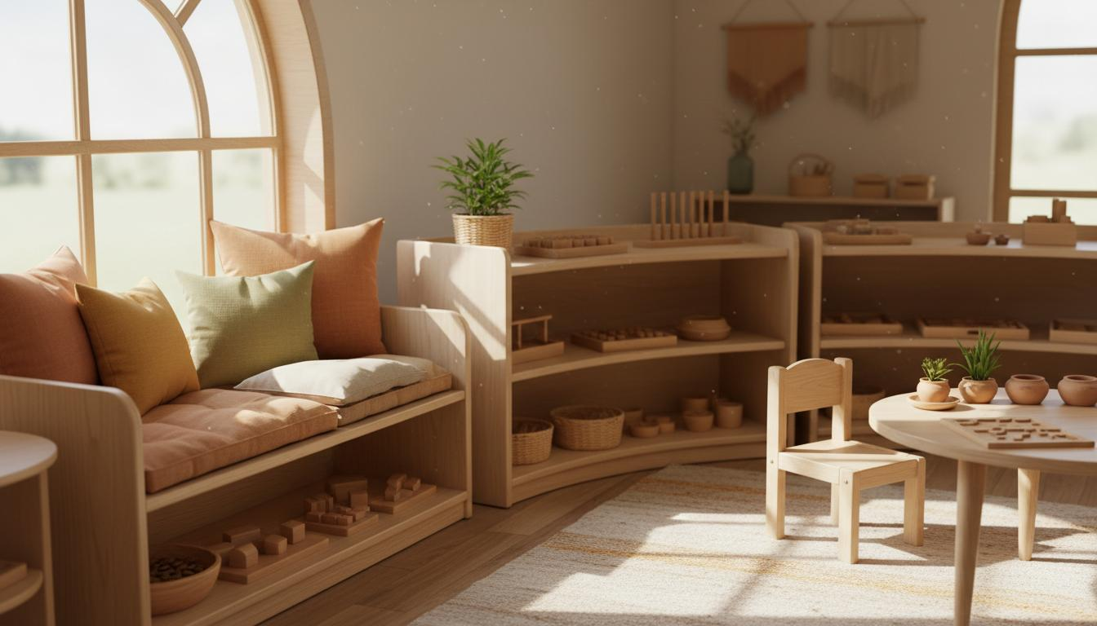
Early Childhood
Development
Storytelling, Motor Skills & Montessori Learning

Slide 2
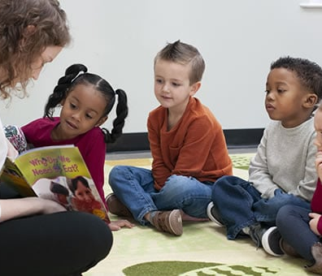
Storytelling for Kids
📖 Opening Worlds Through Words
Develops Imagination
Stories transport children to magical worlds, fostering creativity and imaginative thinking.
Improves Listening Skills
Listening to stories trains children to focus, concentrate, and absorb information attentively.
Builds Vocabulary
Exposure to new words and language patterns enriches children's communication abilities.
✨ Stories help children think and dream.
Teaches Values & Emotions
Stories provide safe spaces to explore feelings, empathy, and moral lessons.

Slide 3

Gross Motor Skills
🏃‍♂️ Big Movements, Big Growth
Big Body Movements
Gross motor skills involve large muscle groups for whole-body movements and coordination.
Balance & Coordination
These skills develop body awareness, spatial orientation, and physical control.
Active Play Activities
Running, jumping, climbing, and dancing build strength and cardiovascular health.
✨ Active body, healthy child.
Builds Confidence
Mastering physical challenges boosts self-esteem and encourages active lifestyles.

Slide 4
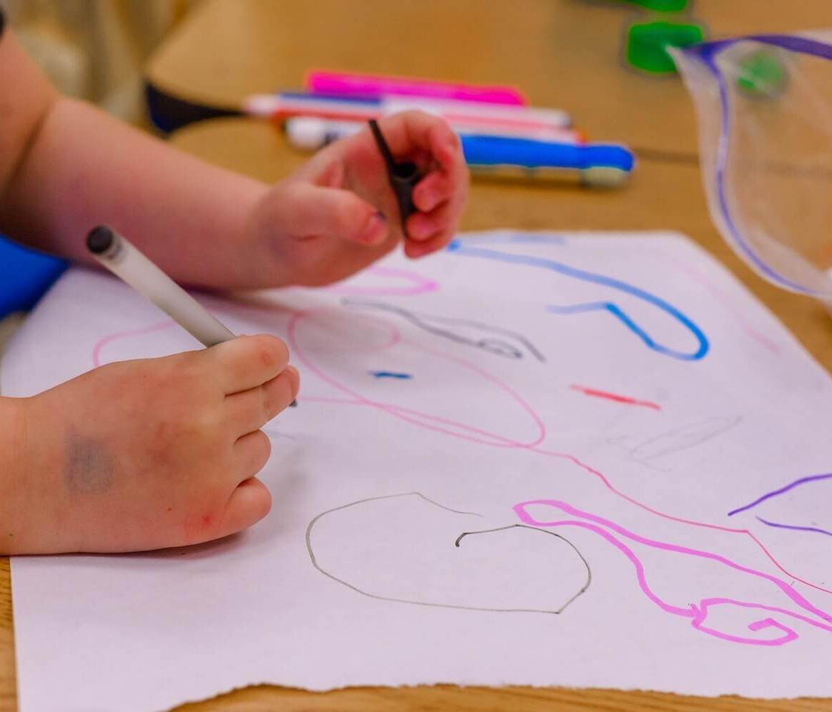
Fine Motor Skills
✋ Small Muscles, Big Skills
Small Muscle Control
Fine motor skills involve precise movements of hands, fingers, and wrists for detailed tasks.
Hand-Eye Coordination
These activities strengthen the connection between visual processing and manual dexterity.
Creative Activities
Drawing, coloring, beading, and cutting develop precision while expressing creativity.
✨ Small hands learning skills.
Prepares for Writing
Strong fine motor skills enable children to hold pencils correctly and write with ease.

Slide 5
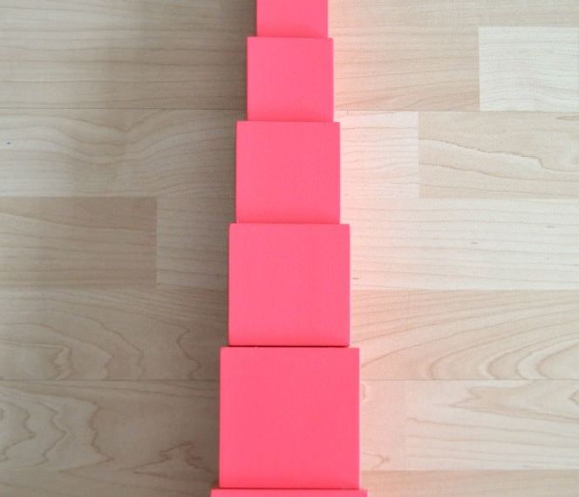
Montessori: Pink Tower
🧊 A Classic Montessori Material
10
Ten Pink Cubes
The Pink Tower consists of 10 wooden cubes in graduated sizes, from 1cm³ to 10cm³.
Size Discrimination
Children arrange cubes from largest to smallest, developing visual and tactile awareness of dimension.
Builds Concentration
The activity requires focus, patience, and precise movements, strengthening attention spans.
✨ Learning by doing.
Understanding Order
Children learn sequencing, comparison, and mathematical concepts through hands-on exploration.

